Slide 1
SDPi Supplement Diagrams

Slide 2
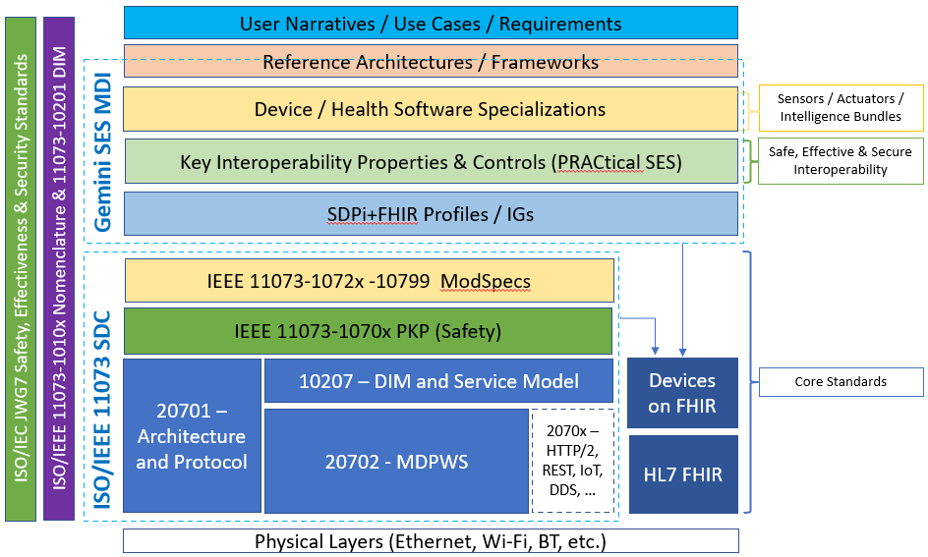
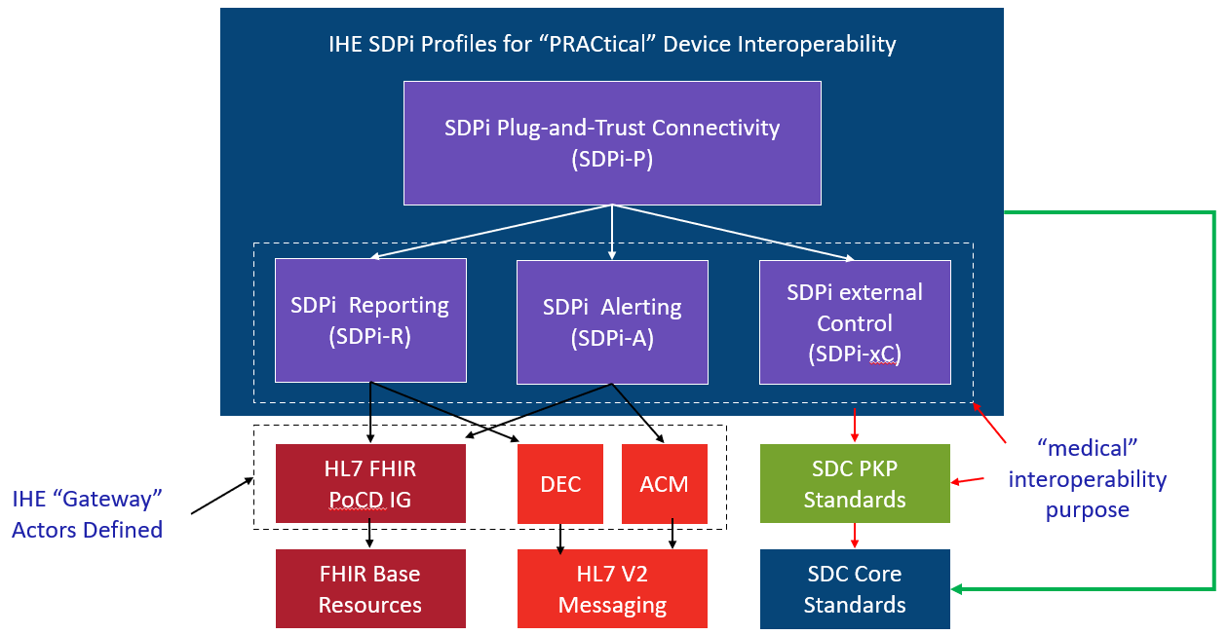
What’s next? SDPi-enabled Profiles …
2020.09.10A
NOTE: Profile Titles are notional – hopefully useful too!
Devices-In-Care (PDP) Profile
Device Specialization Profile
Surgery PoC Profile
ICU PoC Profile
MDIRA ICE Profile
SOMDS@home Profile
IHE (Official) Profile Types:
Transport, Content, Workflow
Or a combination of all (3)
Other types?
Architecture (SOA, MDIRA, SDC, ….?
Single domain / multi-domain?

Slide 3
SDPi-xC Actor Diagram
2020.09.11A
SOMDS Consumer
SOMDS
Medical Control Consumer
DEV-AA Manage Medical External Control
DEV-BB Invoke Medical Control Services
SOMDS
Provider
SOMDS
Medical Control Provider

Slide 4
SDPi-A Actor Diagram
2020.09.15A
SOMDS Consumer
SOMDS
Medical Alert Consumer
DEV-AA Establish Medical Alert Exchange
DEV-BB Publish Medical Alert Update
DEV-CC Retrieve Medical Alert Status
DEV-DD Manage Medical Alert Delegation
DEV-EE Delegate Medical Alert
DEV-FF Update Alert Acknowledgement Status
DEV-AA
SOMDS
ACM Gateway
DEV-04
DEV ACM
SOMDS
Provider
SOMDS
Medical Alert Provider
DEV-CC
DEV-FF
DEV-04
DEV-BB
DEV-05
SOMDS V2 Gateway

Slide 5
SDPi-R Actor Diagram
2020.09.11A
SOMDS Consumer
SOMDS
Medical Data Consumer
DEV-AA
SOMDS
FHIR Medical Data Gateway
FHIR-based Profile Actors / Systems / Applications
DEV-CC
DEV-BB
SOMDS FHIR Gateway
DEV-AA Establish Medical Data Exchange
DEV-BB Publish Medical Data
DEV-CC Retrieve Medical Data
DEV DEC Device Observation Reporter
SOMDS
DEC Gateway
DEV-01
SOMDS
Provider
SOMDS
Medical Data Provider
DEV-AA
DEV DEC Device Observation Consumer
DEV-CC
DEV-01
DEV-BB
SOMDS V2 Gateway

Slide 6
SDPi-P Actor Diagram
2020.08.28A
SOMDS Participant
SOMDS Connector
Non-SOMDS Systems
SOMDS
Provider
(MDIB, Services, …)
SOMDS FHIR Gateway
SOMDS Consumer
(consume MDIB info, invoke services, …)
SOMDS V2 Gateway
SOMDS Sensor Gateway
SOMDS Smart App Platform
Smart Apps
(incl. SAMD)

Slide 7
SDPi-P Content Actor Diagram
2020.08.12A
Provide Content
BICEPS
Content
Creator
BICEPS
Content
Consumer

Slide 8
Diagram Archive

Slide 9
SDPi-A Actor Diagram
2020.09.11A
SOMDS Consumer
SOMDS
Medical Alert Consumer
DEV-AA Establish Medical Alert Exchange
DEV-BB Publish Medical Alert Update
DEV-CC Retrieve Medical Alert Status
DEV-DD Manage Medical Alert Delegation
DEV-EE Delegate Medical Alert
DEV-FF Update Alert Acknowledgement Status
DEV-AA
SOMDS
ACM Gateway
DEV-04
DEV ACM
SOMDS
Provider
SOMDS
Medical Alert Provider
DEV-CC
DEV-FF
DEV-04
DEV-BB
DEV-05
SOMDS V2 Gateway

Slide 10
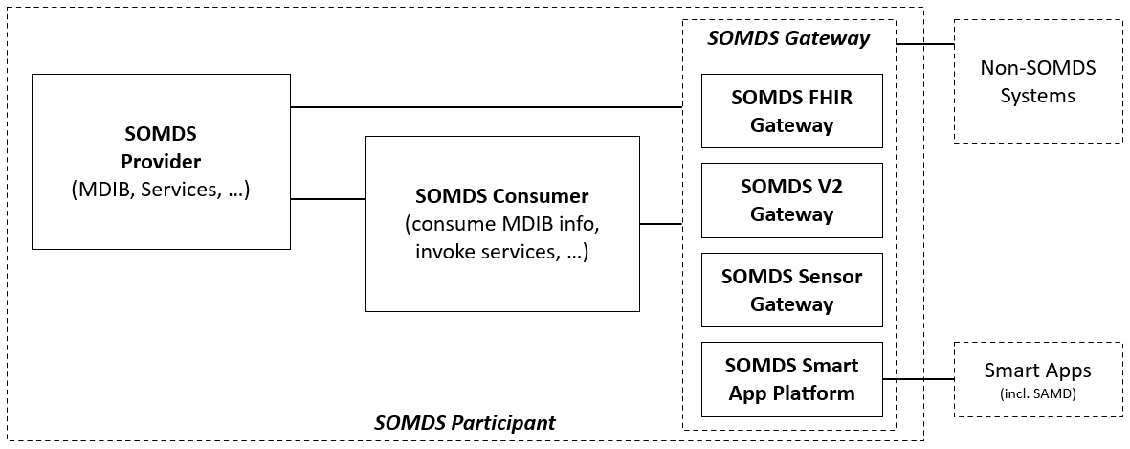
SDPi-P Actor Diagram
2020.08.18A
Lost File!

Slide 11
SDPi-P Actor Diagram
2020.08.14A
SOMDS Participant
Non-SOMDS Systems
SOMDS
Provider
(MDIB, Services, …)
SOMDS Gateway
SOMDS Consumer
(consume MDIB info, invoke services, …)
SOMDS FHIR Gateway
SOMDS V2 Gateway
SOMDS Sensor Gateway

Slide 12
SDPi-P Actor Diagram
2020.08.14A
SOMDS Participant
Non-SOMDS Systems
SOMDS
Provider
(MDIB, Services, …)
SOMDS Gateway
SOMDS Consumer
(consume MDIB info, invoke services, …)
SOMDS FHIR Gateway
SOMDS V2 Gateway
SOMDS Sensor Gateway

Slide 13
SDPi-P Actor Diagram
2020.08.1A
Lost original!

Slide 14
SDPi-P Actor Diagram
2020.08.14A
SOMDS Participant
Non-SOMDS Systems
SOMDS
Provider
(MDIB, Services, …)
SOMDS Gateway
SOMDS Consumer
(consume MDIB info, invoke services, …)
SOMDS FHIR Gateway
SOMDS V2 Gateway
SOMDS Sensor Gateway

Slide 15
SDPi-P Content Actor Diagram
2020.08.12A
Provide Content
BICEPS
Content
Creator
BICEPS
Content
Consumer

Slide 16
SDPi-P Actor Diagram
2020.08.10B
SOMDS Participant
Non-SOMDS Systems
SOMDS
Provider
(MDIB, Services, …)
SOMDS Gateway
SOMDS Consumer
(consume MDIB info, invoke services, …)
SOMDS FHIR Gateway
SOMDS V2 Gateway
Workflow Context? Actor?
Ensemble Context? Actor?

Slide 17
SDPi-P Content Actor Diagram
2020.08.07D
Provide Content
SOMDS
Content
Creator
SOMDS
Content
Consumer
(SOMDS-Based Exchange)

Slide 18
SDPi-P Actor Diagram
2020.08.07C
SOMDS Participant
Non-SOMDS Systems
SOMDS
Provider
(MDIB, Services, …)
SOMDS Gateway
SOMDS Consumer
(consume MDIB info, invoke services, …)
SOMDS FHIR Gateway
SOMDS V2 Gateway
Workflow Context? Actor?
Ensemble Context? Actor?

Slide 19
SDPi-P Actor Diagram
2020.08.07B
SOMDS Participant
Non-SOMDS Systems
SOMDS
Provider
(MDIB, Services, …)
SOMDS Gateway
SOMDS Consumer
(consume MDIB info, invoke services, …)
SDC-FHIR Gateway
SDC-V2 Gateway
Workflow Context? Actor?
Ensemble Context? Actor?

Slide 20
SDPi-P Actor Diagram
2020.08.07A
SOMDS Participant
Non-SOMDS Systems
SOMDS
Provider
(MDIB, Services, …)
SOMDS
Gateway
SOMDS Consumer
(consume MDIB info, invoke services, …)
SDC-FHIR Gateway
SDC-V2 Gateway
Workflow Context? Actor?
Ensemble Context? Actor?

Slide 21
SDPi-P Actor Diagram
2020.08.06A
SOMDS Participant (MDIB, Context, …)
Non-SOMDS Systems
SOMDS
Provider
(MDIB, Services, …)
SOMDS
Gateway / Enterprise Proxy
SOMDS Consumer
(consume MDIB info, invoke services, …)
SDC-FHIR Gateway Proxy OR
EHR Proxy
OR
Patient Identity
…
Workflow Context? Actor?
Ensemble Context? Actor?

